Slide 1
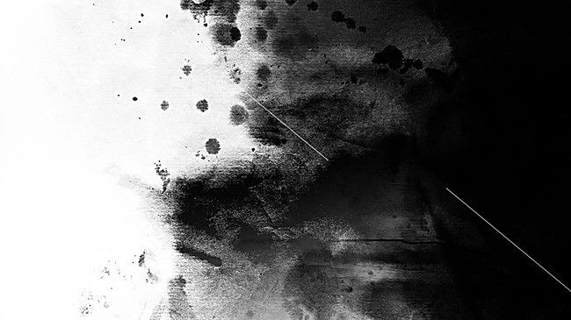
The Tattoo Gallery
Lakshmi Shaji

Slide 2
GENESIS
I have a couple tattoos and finding an artist on my own is hard.
Traditionally, I would google tattoo shops in my area using google.
I would go to their website and view their work. Maybe browse their social media.
Think about if this is the right choice, if people have had good experiences and PANIC.

Slide 3
PROJECT VISION
For people within the general public whose current experience finding tattoo artists is a long and time-consuming process, the Tattoo Gallery is a centralized application/site that will decrease the time spent researching artists by providing a platform for tattoo centered content.

Slide 4
PRIMARY DIFFERENCES
This application is different from Google, Instagram and other social media sites because our product provides location centered data for tattoo artists in the area and provides portfolio of work for customers to browse the style of the artists. This product will reduce the amount of time that someone spends researching for tattoo artists by giving all the information that is necessary to make a decision in one place.

Slide 5
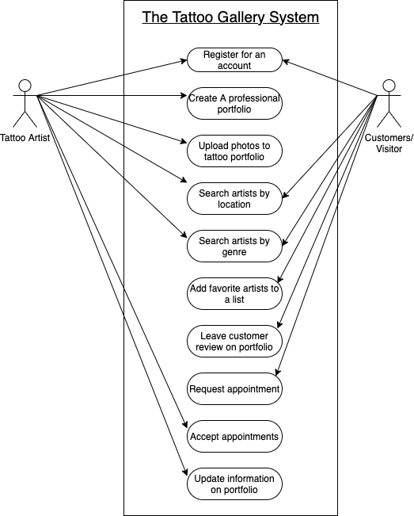
USE CASES

Slide 6
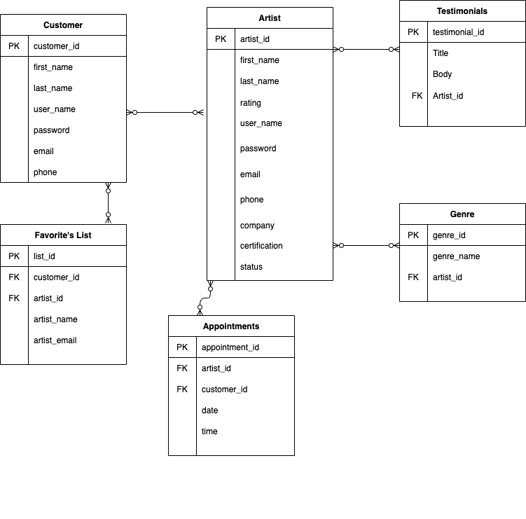
DATA MODEL

Slide 7
UI Screens

Slide 8
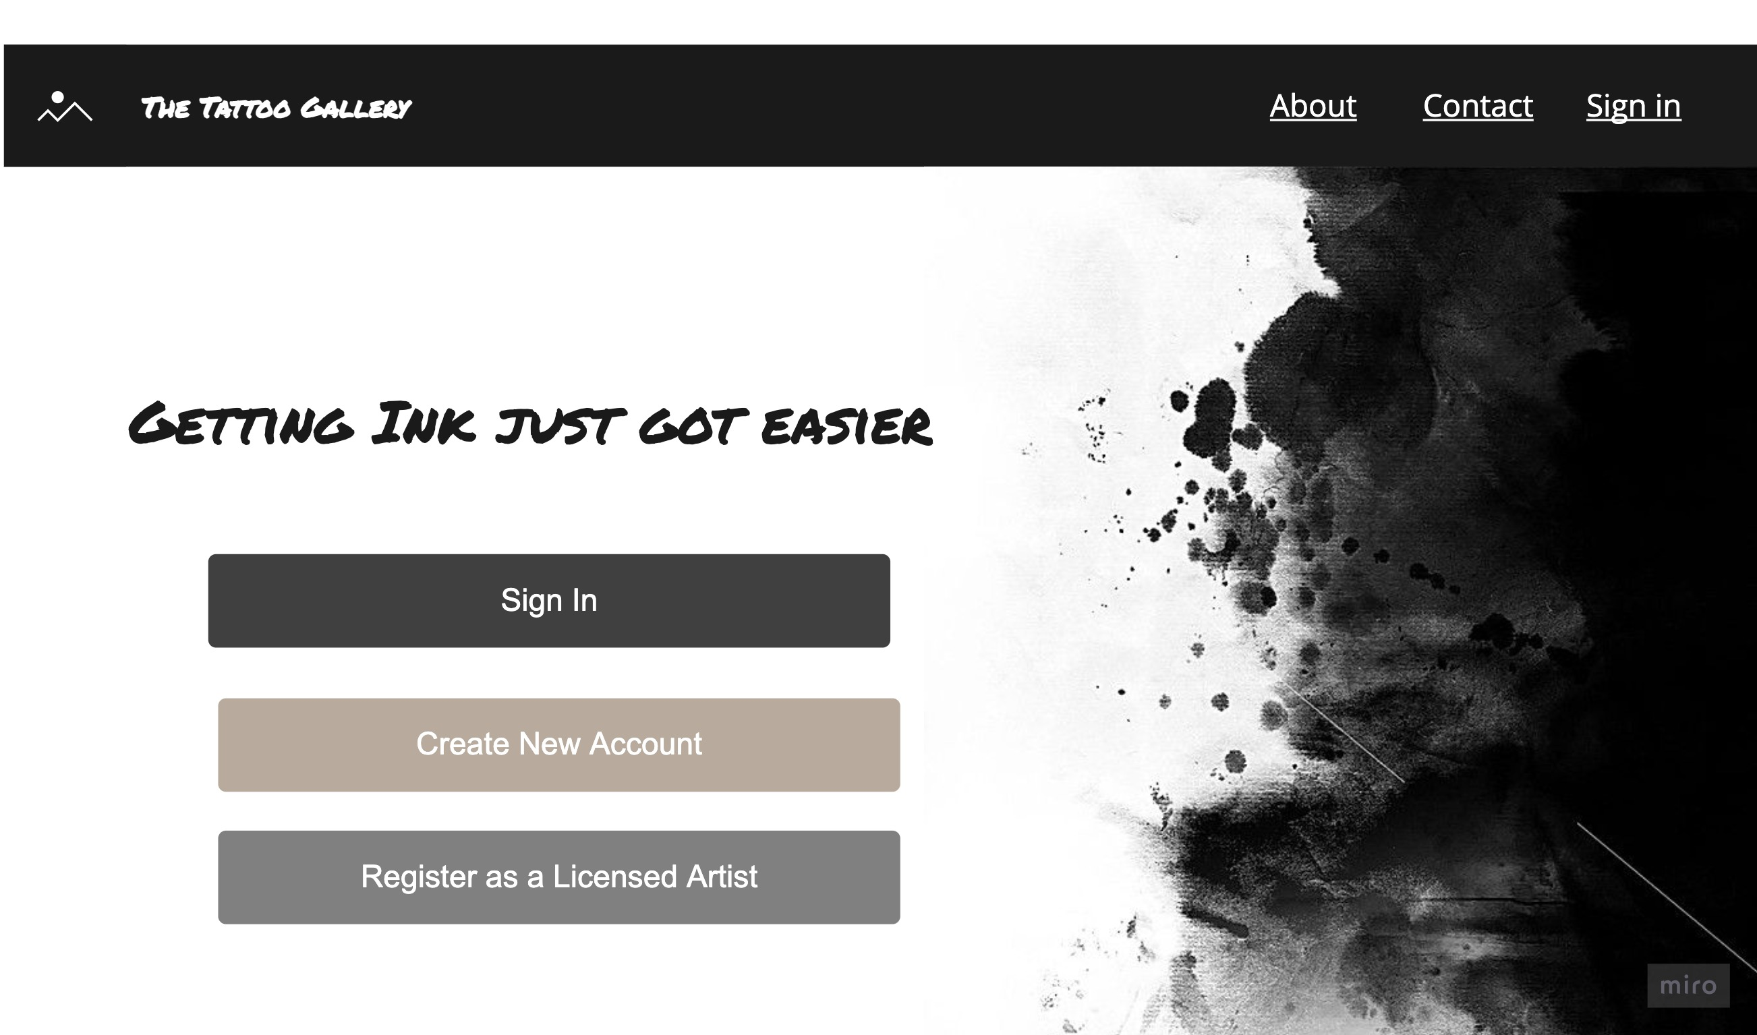

Slide 9
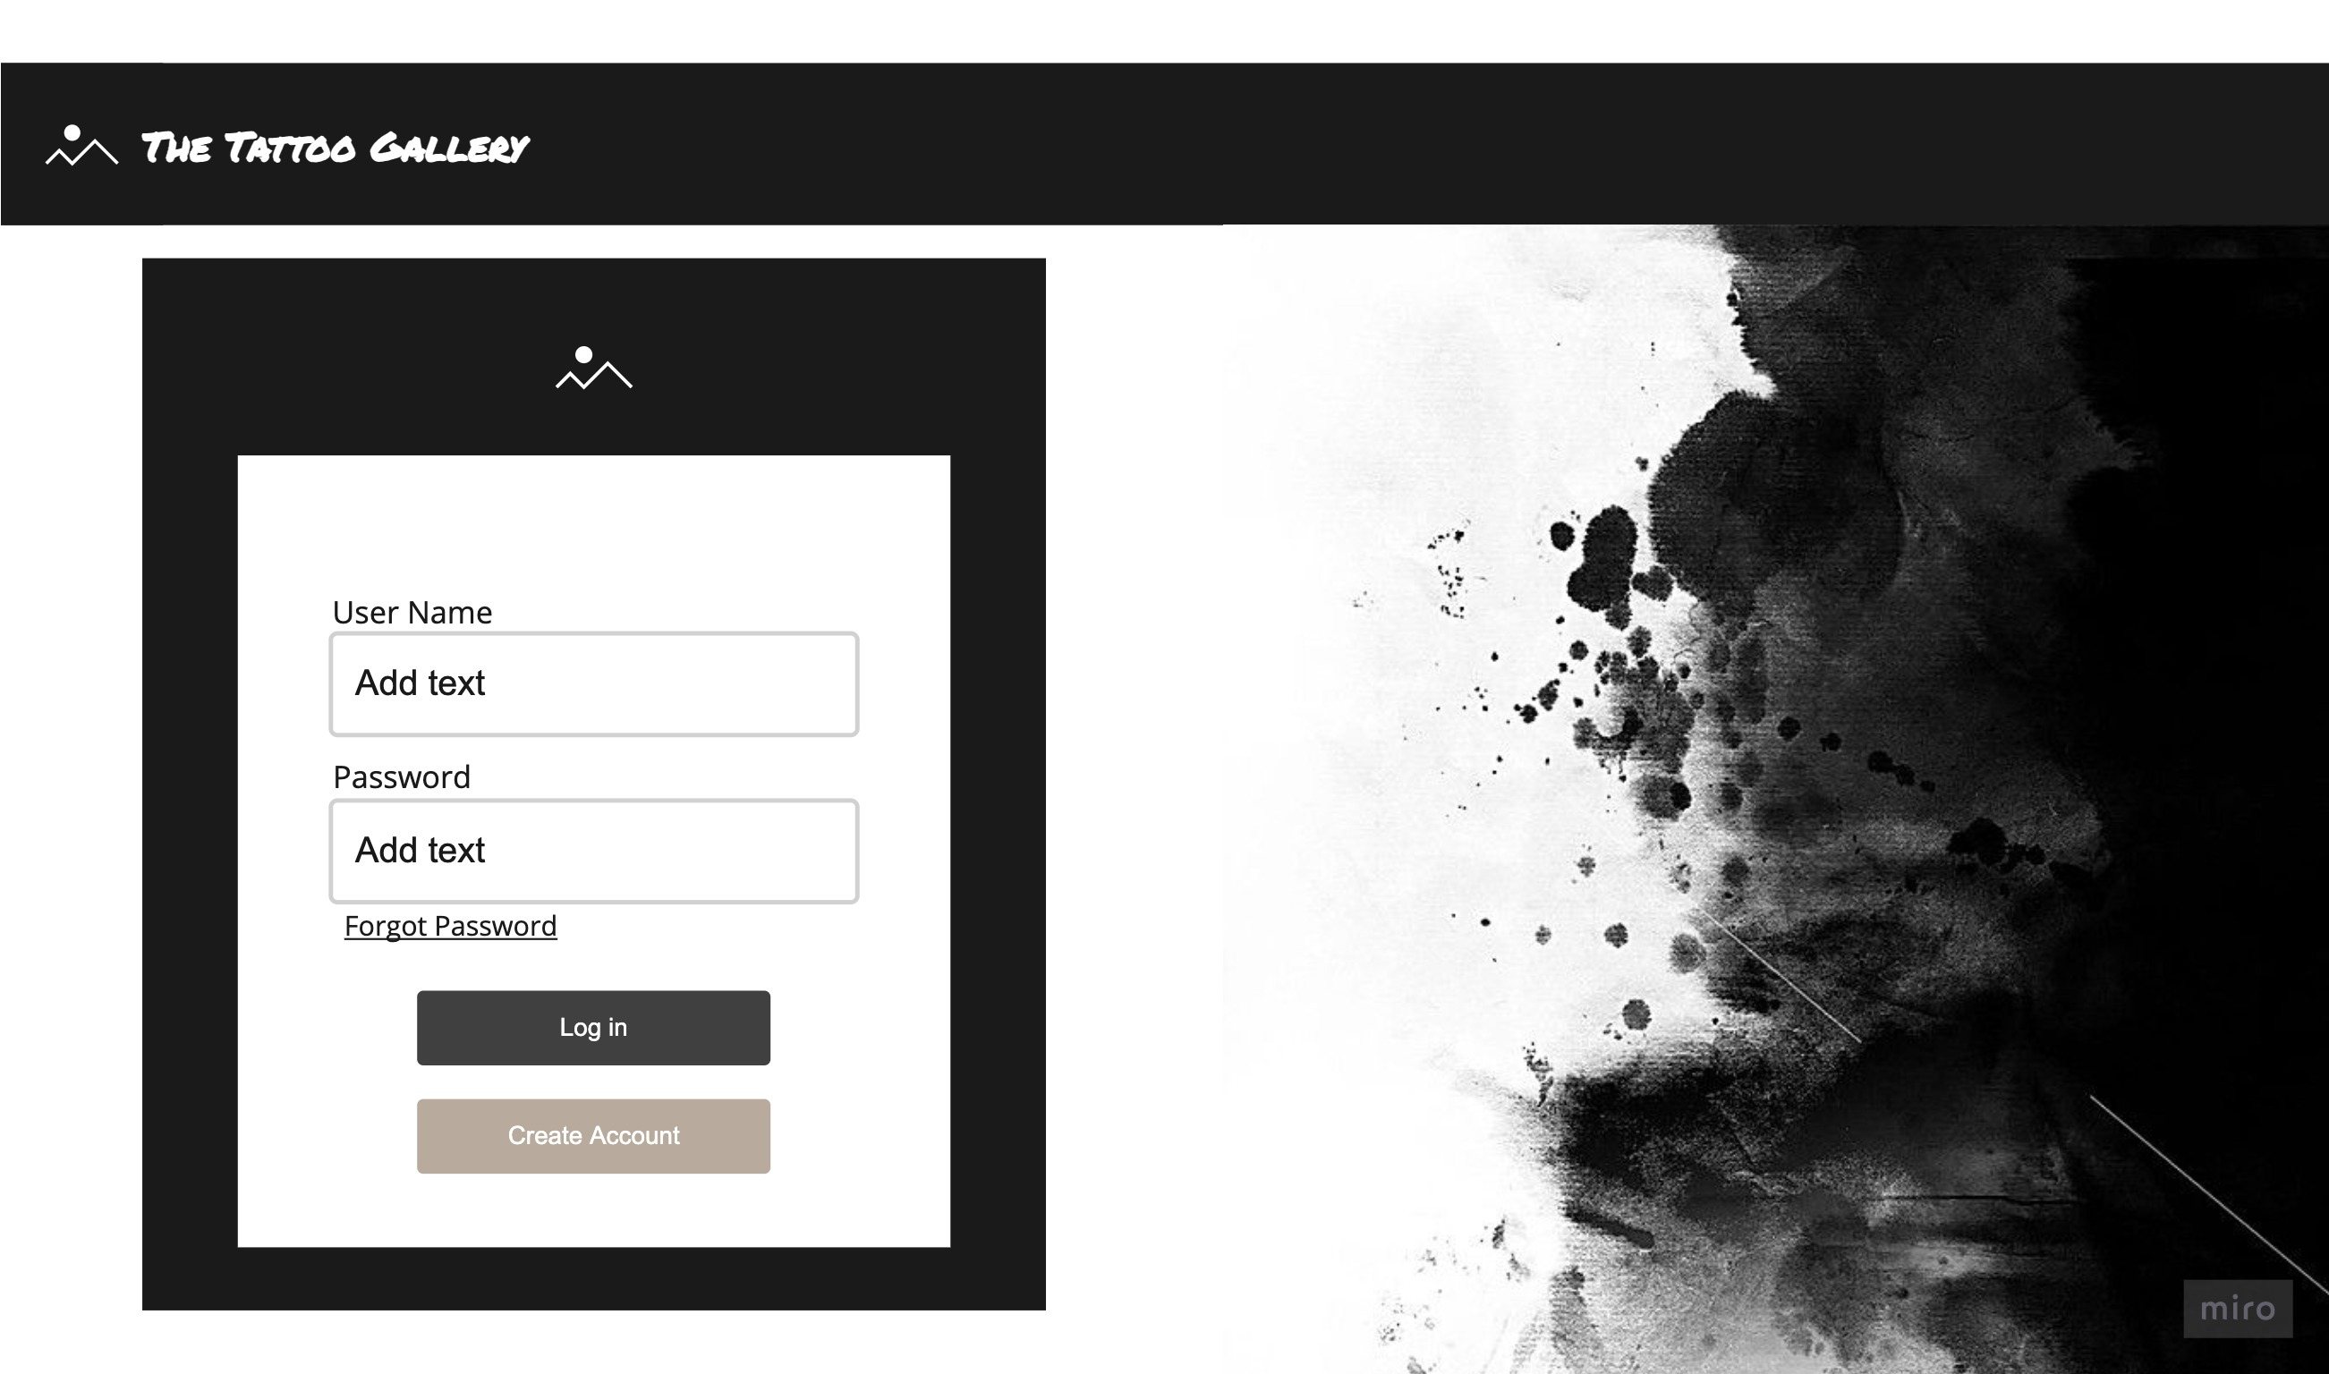

Slide 10
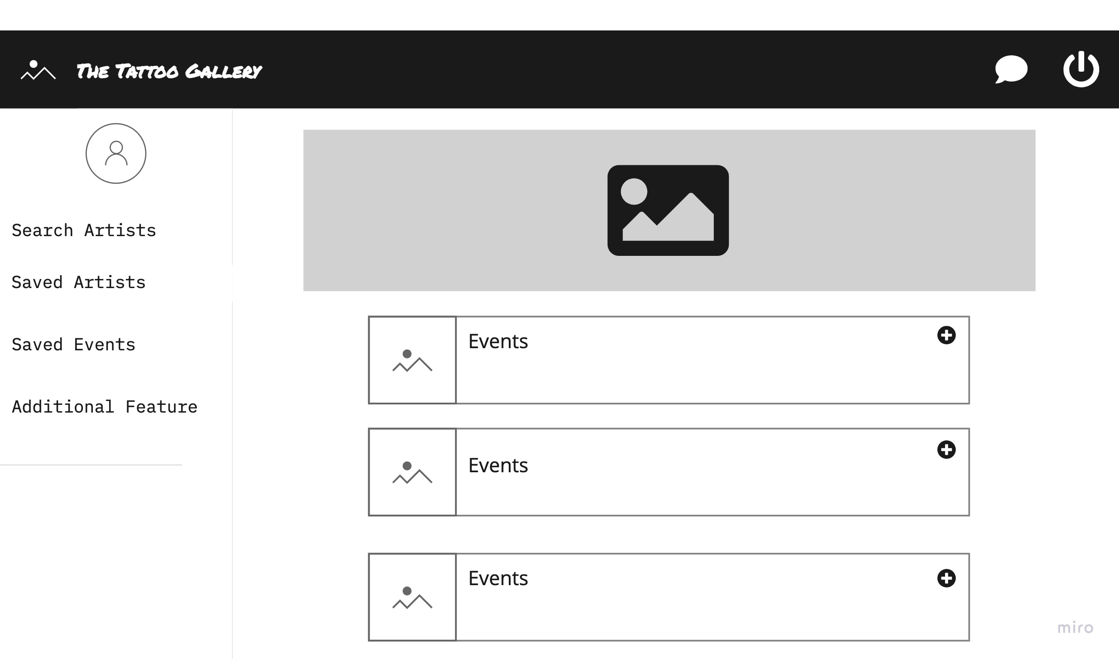

Slide 11
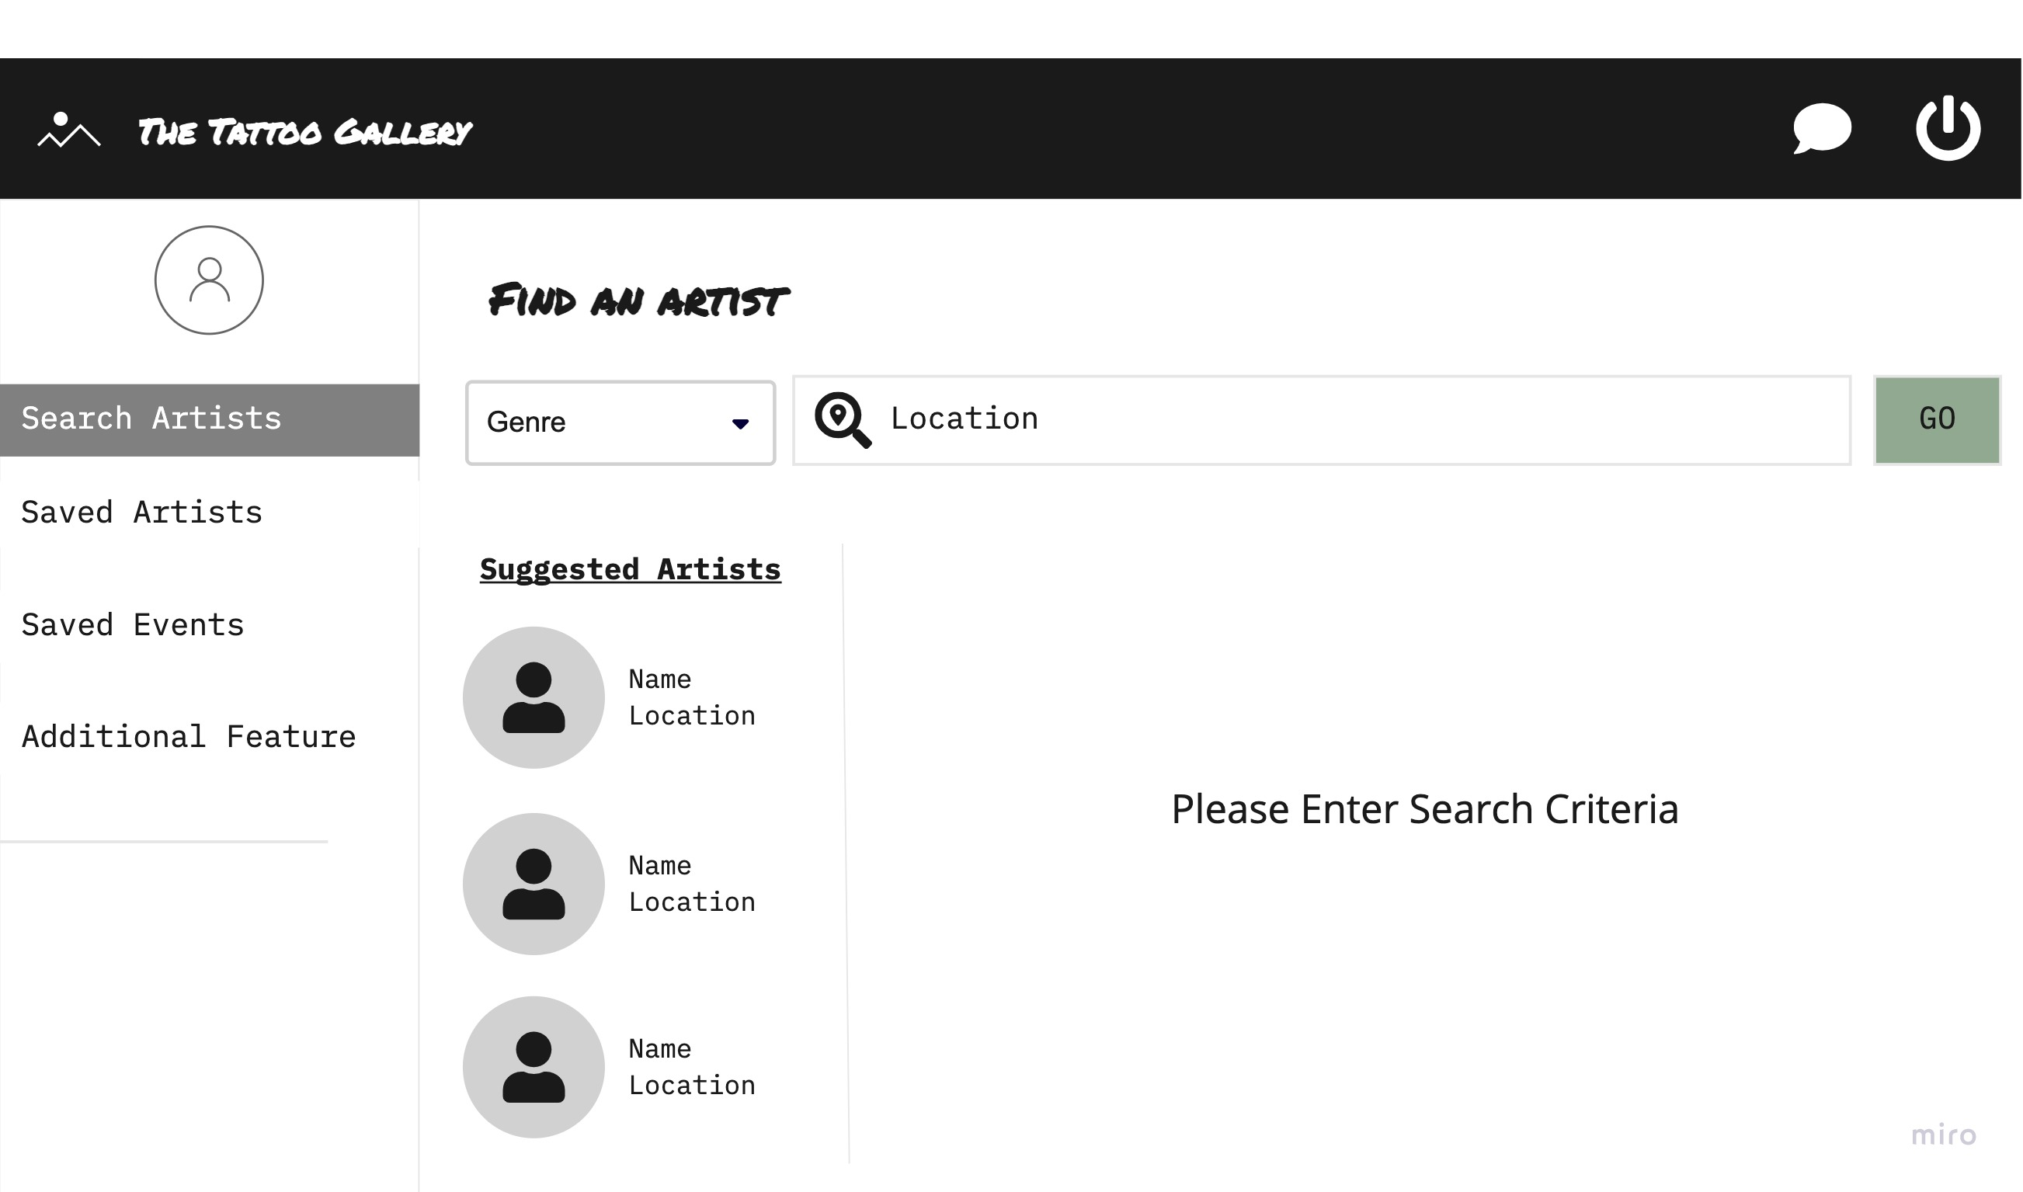

Slide 12
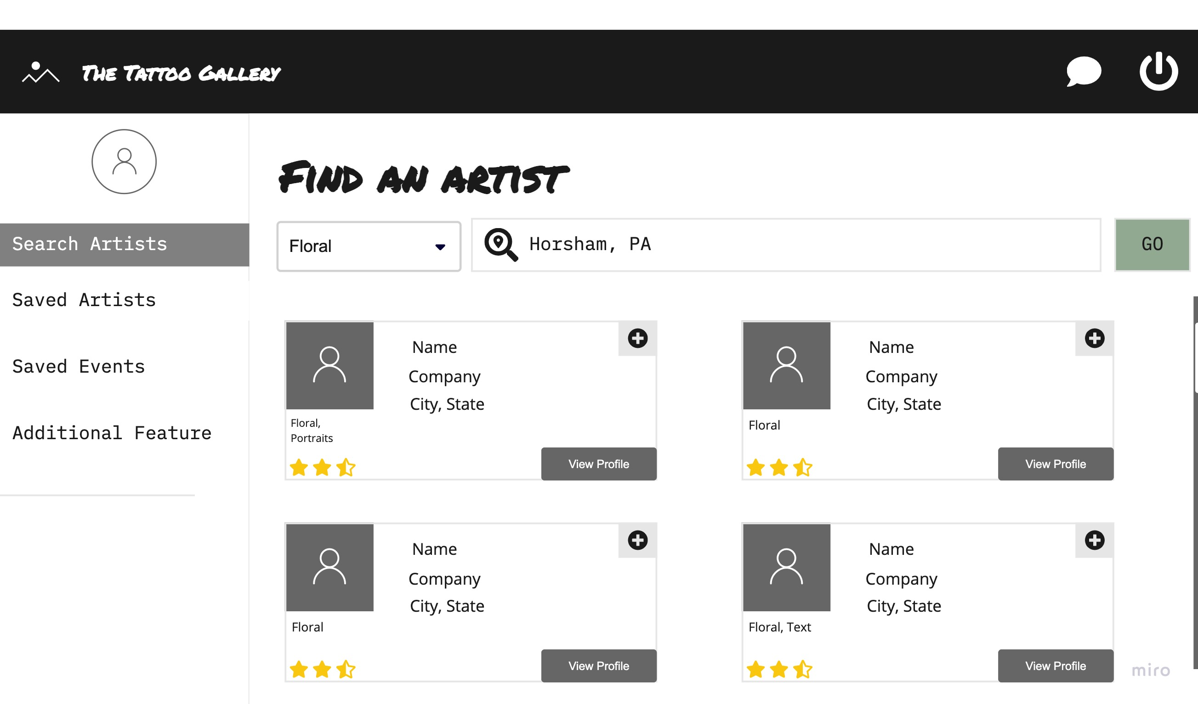

Slide 14
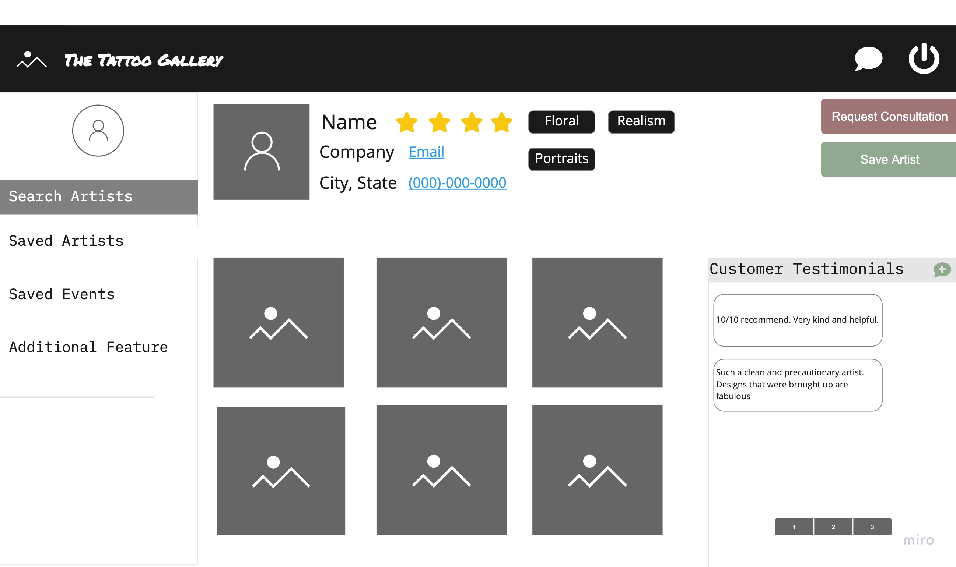

Slide 15
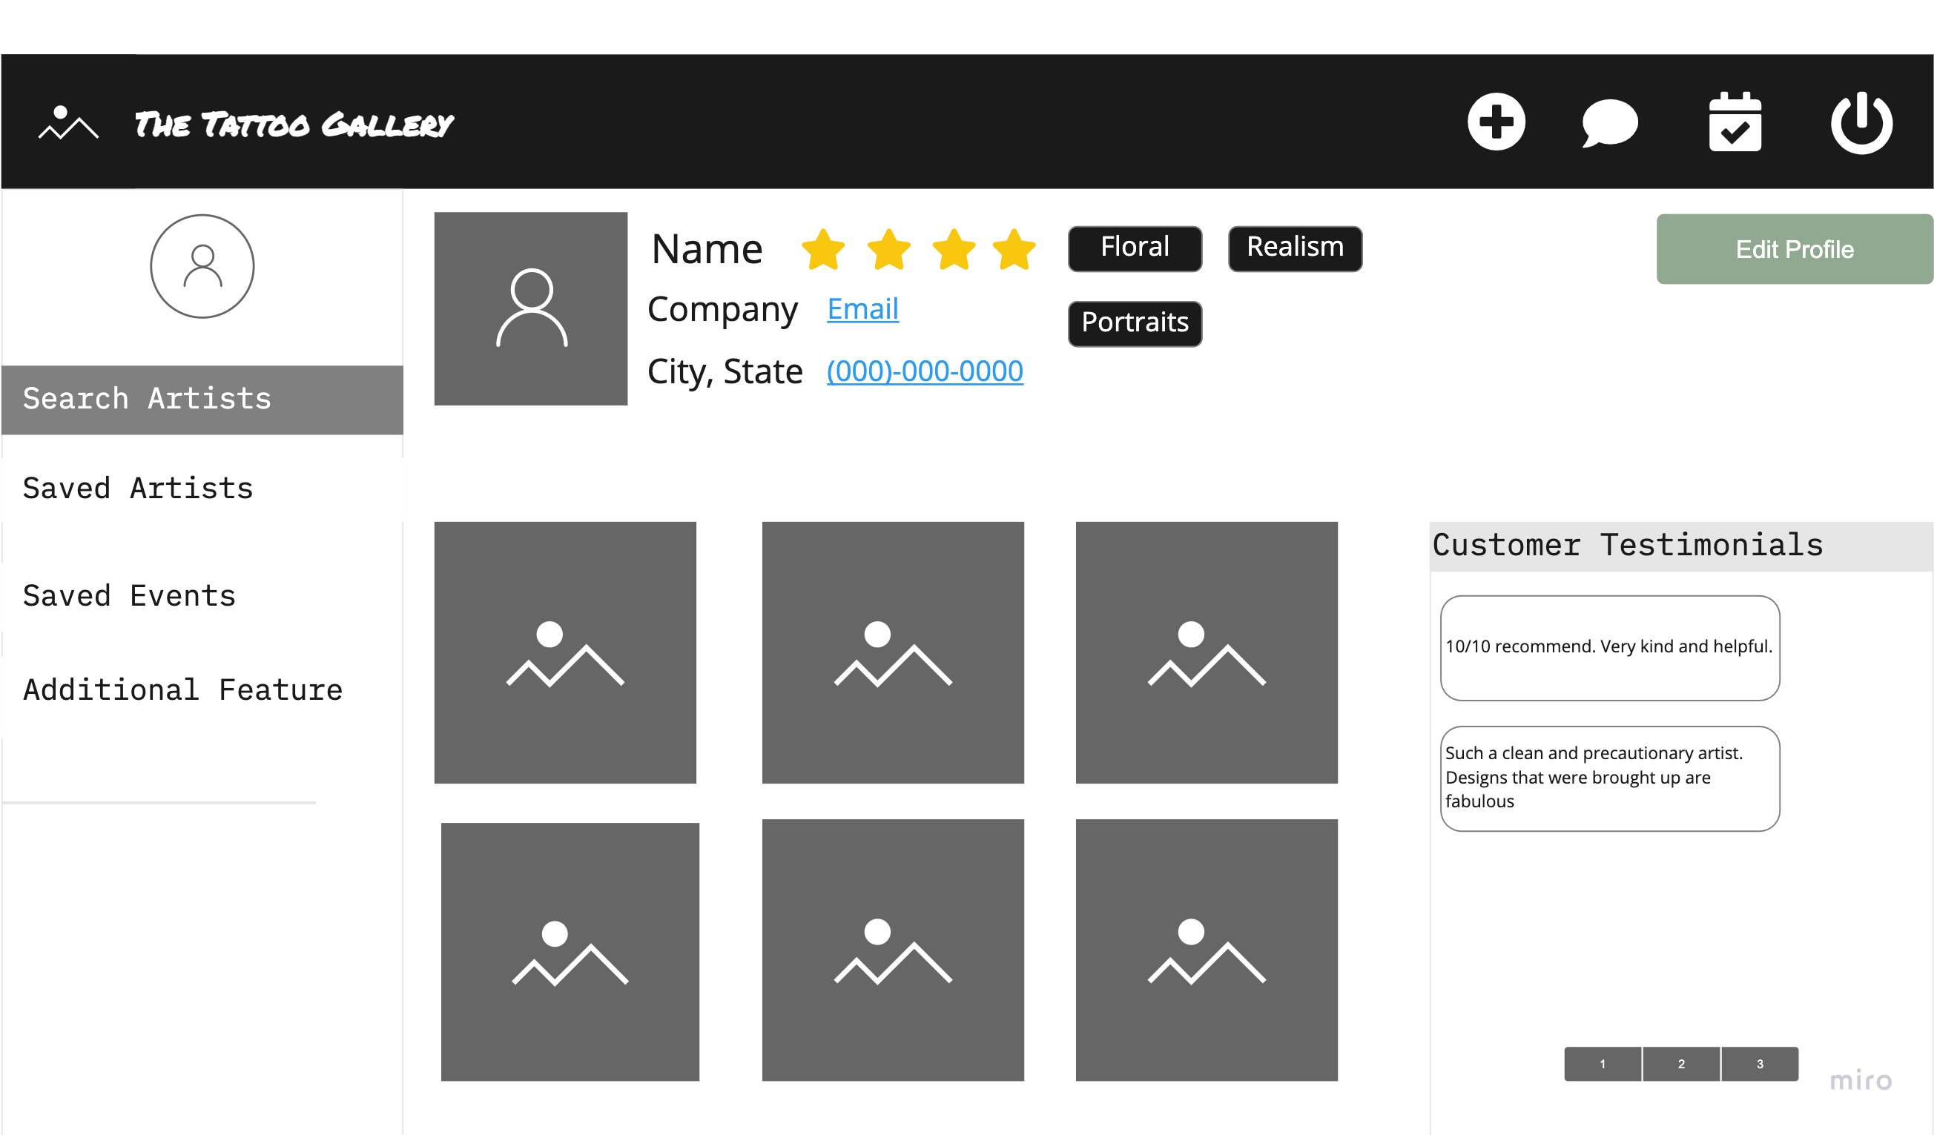

Slide 16
What’s Next?

Slide 17
RESEARCH
RECONSIDER BRAND
TATTOO LISCENSING INFORMATION
ECOMMERCE?
TATOO AND PIERCING?
SCHEDULING CALENDAR

Slide 18
QUESTIONS?

